Slide 1
Rockbuster Streaming 2020 Launch Strategy
Katie Kulp, March 2023

Slide 2
Transitioning to a Streaming Service
Over the last decade movie rentals have shifted from brick-and-mortar stores to streaming, as people now prefer the convenience of watching their favorite movies and TV shows online. With a highly competitive streaming industry, Rockbuster will stand out by offering a unique blend of nostalgia and quality content.
Questions to Consider
1 | Which movies contributed the most to revenue gain? | What genres and actors should Rockbuster focus on marketing and acquiring?
2 | What was the average rental duration for all videos? | How long should online rentals last?
3 | Which countries are Rockbuster customers based in? Do sales figures vary between geographic regions? | Where should Rockbuster focus marketing and resources?
4 | Are there customers with a high lifetime value? Where are they based? | Should rewards programs be available for high value customers?

Slide 3
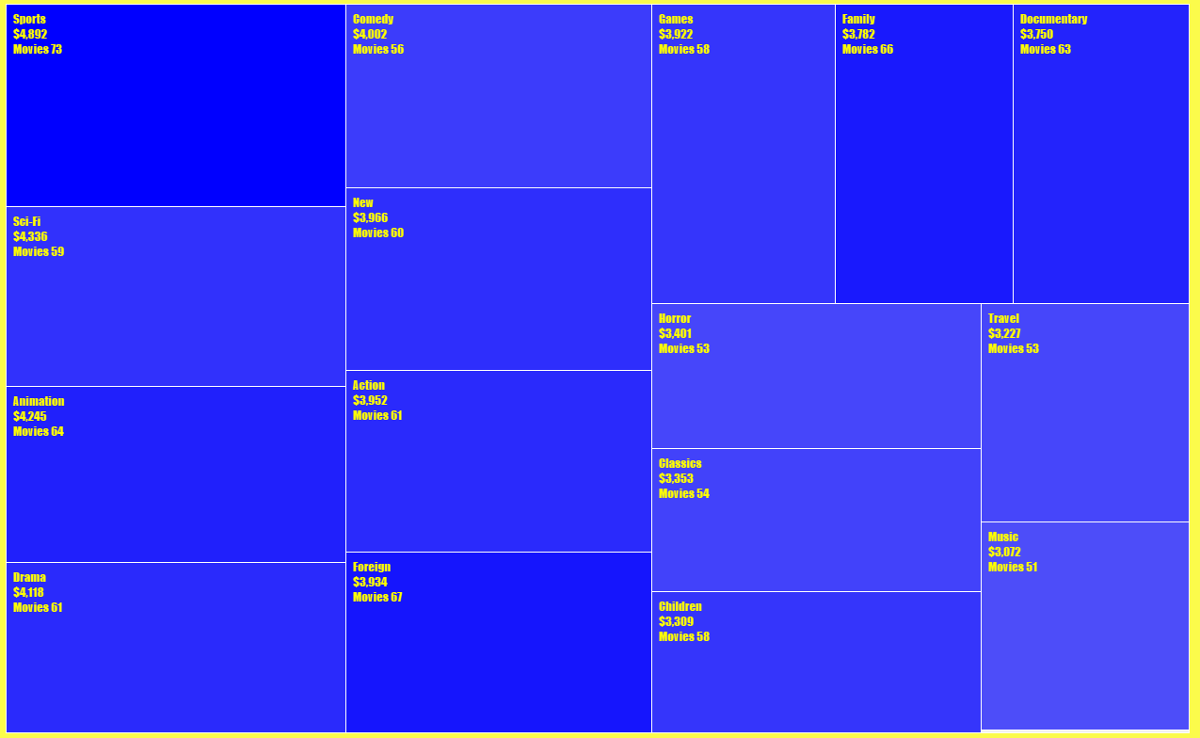
Which Genres Contributed the Most to Revenue Gain?
Insights:
Sports, Sci-Fi, and Animation movies are of the highest revenue generating movies, although the revenue of all genres was pretty comparable.
Recommendations:
-Acquiring movies in the popular genres.
-Keeping a wide variety of genres of movies to appeal to all audiences.
-Marketing focusing on popular genres.

Slide 4
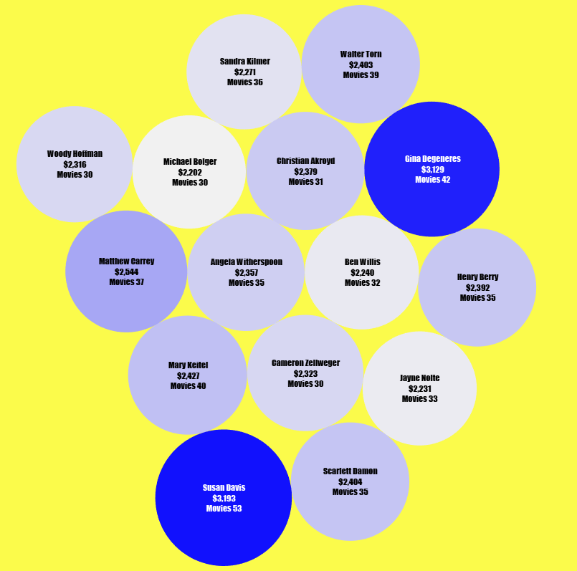
Which Actors Contributed the Most to Revenue Gain?
Insights:
Susan Davis, Gina Degeneres, and Matthew Carrey are among the actors associated with the highest amount of revenue.
Recommendations:
-Acquiring movies with actors popular to Rockbuster audiences.
-Marketing focusing on popular actors.

Slide 5
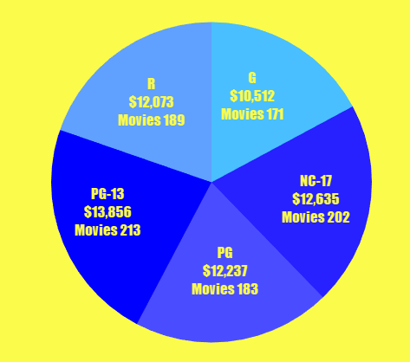
Which Ratings Contributed the Most to Revenue Gain?
Insights:
PG-13 and NC-17 movies had the highest revenue with G movies being the lowest.
Recommendations:
-Marketing focusing on older audiences who may be watching PG-13 and NC-17.
-Separate subscription plans for kids movies with G ratings at lower prices

Slide 6
What was the average rental duration for all videos?
Insights:
People typically kept rentals for about 5 days, and the average rental rate was about 3$.
 | Rental Duration | Rental Rate | Movie Length | Replacement Cost
Average | 4.9 days | 2.98$ | 115.3 mins | 19.98$
Min | 3 days | 0.99$ | 46 mins | 9.99$
Max | 7 days | 4.99$ | 185 min | 29.99$
Recommendations:
-Rental rates could remain the same between 1-5$
-The rental duration could be made to be the average, 5 days long. This could be a perk over other streaming services where rental duration is typically shorter.

Slide 7
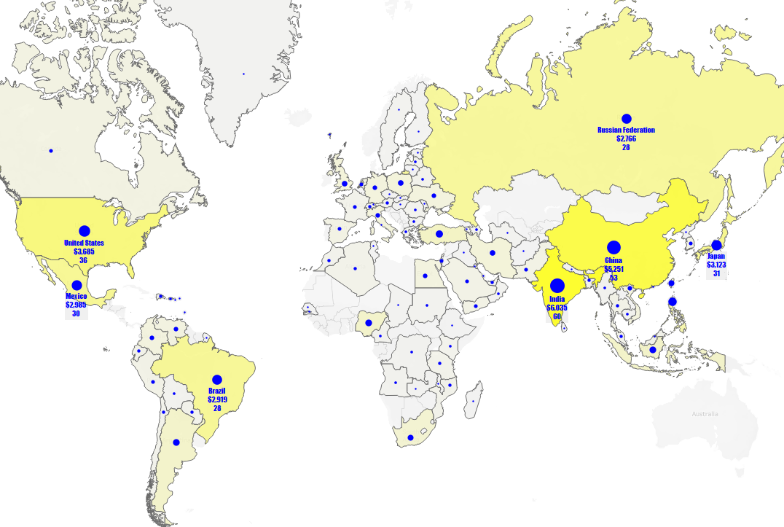
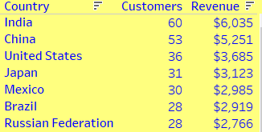
What Countries are Rockbuster Customers Based in?
Insights:
Rockbuster customers can be found all over the world, however there are a few countries making a larger impact on revenue.
Recommendations:
-Investing in dubbing or subtitling movies in the languages of these countries.
-Content acquisition for movies and actors from these countries.
-Marketing focusing on popular countries.

Slide 8
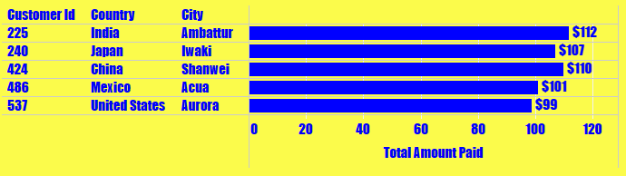
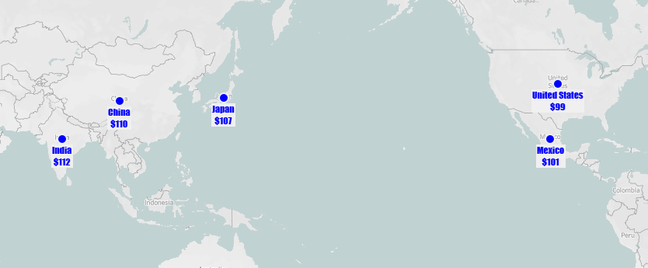
Are there customers with a high lifetime value? Where are they based?
Insights:
The top 5 customers are based in India, Japan, China, Mexico, and the US.
Recommendations:
- Loyalty programs for customers that rent over a certain threshold of movies.
-Special subscription options for early access to favorite movies.
-Marketing for special subscriptions deals and discounts on rentals.

Slide 9
Summary
By leveraging the data and insights, a plan can be made to develop Rockbuster streaming into a unique and innovative platform that stands out in the crowded market. Using strategic approach to content acquisition, marketing, localization, and revenue strategy we can aim to attract and retain a loyal customer base.
What have we found so far?
1 | Which movies contributed the most/least to revenue gain? | Rockbuster customers value a diverse selection of movies. Although there are certain genres, actors, and ratings that attract more revenue, an effort should be made to keep a wide assortment.
2 | What was the average rental duration for all videos? | 5 days rentals and rates between 1-5$ have been successful in the past.
3 | Which countries are Rockbuster customers based in? Do sales figures vary between geographic regions? | India, China, US, Japan, Mexico, Brazil, and Russian Federation should be the target of marketing and content.
4 | Are there customers with a high lifetime value? Where are they based? | Loyal customers are valuable and special programs should be offered to those who rent regularly.

Slide 10
Thank You and Please Reach out with any Questions!
Katie Kulp
kkulp@rockbuster.com

